Slide 1


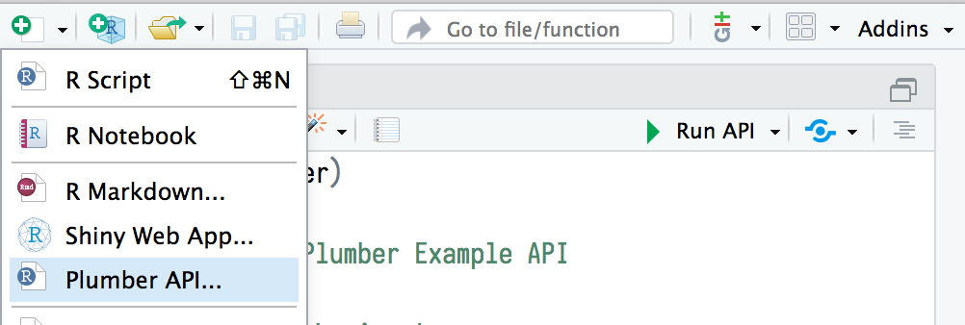

REST APIs with plumber: : CHEATSHEET
Introduction to REST APIs
Plumber pipeline
Running Plumber APIs
Web APIs use HTTP to communicate between client and server.
Plumber endpoints contain R code that is executed in response to an HTTP request. Incoming requests pass through a set of mechanisms before a response is returned to the client.
Plumber APIs can be run programmatically from within an R session.
HTTP
Path to API definition
?
request
HTTP
?
FILTERS
library(plumber)
plumb("plumber.R") %>%
pr_run(port = 5762)
client
response
server
Filters can forward requests (after potentially mutating them), throw errors, or return a response without forwarding the request. Filters are defined similarly to endpoints using the @filter [name] tag. By default, filters apply to all endpoints. Endpoints can opt out of filters using the @preempt tag.
Specify API port
HTTP is built around a request and a response. A client makes a request to a server, which handles the request and provides a response. Requests and responses are specially formatted text containing details and data about the exchange between client and server.
This runs the API on the host machine supported by the current R session.
IDE INTEGRATION
Publish API to Posit Connect
REQUEST
Path
PARSER
HTTP Method
curl -v “http://httpbin.org/get”
#> GET / get HTTP/1.1
#> Host: httpbin.org
#> User-Agent: curl/7.55.1
#> Accept: */*
#
# Request Body
Parsers determine how Plumber parses the incoming request body. By default Plumber parses the request body as JavaScript Object Notation (JSON). Other parsers, including custom parsers, are identified using the @parser [parser name] tag. All registered parsers can be viewed with registered_parsers().
Create new Pumber API
HTTP Version
Run API in current R session
Headers
Documentation
ENDPOINT
Plumber APIs automatically generate an OpenAPI specification file. This specification file can be interpreted to generate a dynamic user-interface for the API. The default interface is generated via Swagger.
Message body
Endpoints define the R code that is executed in response to incoming requests. These endpoints correspond to HTTP methods and respond to incoming requests that match the defined method.
RESPONSE
HTTP Version
Status code
Reason phrase
METHODS
Endpoint details
#< HTTP/1.1 200 OK
#< Connection: keep-alive
#< Date: Thu, 02 Aug 2018 18:22:22 GMT
#
# Response Body
@get - request a resource
@post - send data in body
@put - store / update data
@delete - delete resource
@head - no request body
@options - describe options
@patch - partial changes
@use - use all methods
Headers
Parameter details
Edit parameters
Message body
SERIALIZER
Send request
Plumber: Build APIs with R
Serializers determine how Plumber returns results to the client. By default Plumber serializes the R object returned into JavaScript Object Notation (JSON). Other serializers, including custom serializers, are identified using the @serializer [serializer name] tag. All registered serializers can be viewed with registered_serializers().
Plumber uses special comments to turn any arbitrary R code into API endpoints. The example below defines a function that takes the msg argument and returns it embedded in additional text.
curl command used to send request
Plumber comments begin with #*
@ decorators define API characteristics
library(plumber)
#* @apiTitle Plumber Example API
#* Echo back the input
#* @param msg The message to echo
#* @get /echo
function(msg = "") {
list(
msg = paste0(
"The message is: '", msg, "'")
)
}
Identify as filter
Filter name
library(plumber)
#* @filter log
function(req, res) {
print(req$HTTP_USER_AGENT)
forward()
}
#* Convert request body to uppercase
#* @preempt log
#* @parser json
#* @post /uppercase
#* @serializer json
function(req, res) {
toupper(req$body)
}
Interact with the API
Forward
Once the API is running, it can be interacted with using any HTTP client. Note that using httr requires using a separate R session from the one serving the API.
HTTP Method
/<path> is used to define the location of the endpoint
Endpoint description
(resp <- httr::GET("localhost:5762/echo?msg=Hello"))
#> Response [http://localhost:5762/echo?msg=Hello]
#> Date: 2018-08-07 20:06
#> Status: 200
#> Content-Type: application/json
#> Size: 35 B
httr::content(resp, as = "text")
#> [1] "{\"msg\":[\"The message is: 'Hello'\"]}"
Parser
Output of the log
HTTP Method
Endpoint path
Serializer
CC BY SA Posit Software, PBC • info@posit.co • posit.co • Learn more at www.rplumber.io • HTML cheatsheets at pos.it/cheatsheets • plumber 1.2.2 • Updated: 2024-05

Slide 2
Programmatic Plumber
Advanced Plumber
Tidy Plumber
REQUEST and RESPONSE
ASYNC PLUMBER
Plumber is exceptionally customizable. In addition to using special comments to create APIs, APIs can be created entirely programatically. This exposes additional features and functionality. Plumber has a convenient “tidy” interface that allows API routers to be built piece by piece. The following example is part of a standard plumber.R file.
Plumber provides access to special req and res objects that can be passed to Plumber functions. These objects provide access to the request submitted by the client and the response that will be sent to the client. Each object has several components, the most helpful of which are outlined below:
Plumber supports asynchronous execution via the future R package. This pattern allows Plumber to concurrently process multiple requests.
library(plumber)
#* @plumber
function(pr) {
pr %>%
pr_get(path = "/echo",
handler = function(msg = "") {
list(msg = paste0(
"The message is: '",
msg,
"'")
)
}) %>%
pr_get(path = "/plot",
handler = function() {
rand <- rnorm(100)
hist(rand)
},
serializer = serializer_png()) %>%
pr_post(path = "/sum",
handler = function(a, b) {
as.numeric(a) + as.numeric(b)
})
}
library(plumber)
future::plan("multisession")
#* @get /slow
function() {
promises::future_promise({
slow_calc()
})
}
Use @plumber tag
Name | Example | Description
req
req$pr | plumber::pr() | The Plumber router processing the request
req$body | list(a=1) | Typically the same as argsBody
req$argsBody | list(a=1) | The parsed body output
req$argsPath | list(c=3) | The values of the path arguments
req$argsQuery | list(e=5) | The parsed output from req$QUERY_STRING
req$cookies | list(cook = "a") | A list of cookies
req$REQUEST_METHOD | "GET" | The method used for the HTTP request
req$PATH_INFO | "/" | The path of the incoming HTTP request
req$HTTP_* | "HTTP_USER_AGENT" | All of the HTTP headers sent with the request
req$bodyRaw | charToRaw("a=1") | The raw() contents of the request body
res
res$headers | list(header = "abc") | HTTP headers to include in the response
res$setHeader() | setHeader("foo", "bar") | Sets an HTTP header
res$setCookie() | setCookie("foo", "bar") | Sets an HTTP cookie on the client
res$removeCookie | removeCookie("foo") | Removes an HTTP cookie
res$body | "{\"a\":[1]}" | Serialized output
res$status | 200 | The response HTTP status code
res$toResponse() | toResponse() | A list of status, headers, and body
Set the execution plan
Function that accepts and modifies a plumber router
Slow calculation
“Tidy” function for building out Plumber API
MOUNTING ROUTERS
Plumber routers can be combined by mounting routers into other routers. This can be beneficial when building routers that involve several different endpoints and you want to break each component out into a separate router. These separate routers can even be separate files loaded using plumb().
Create an initial router
library(plumber)
route <- pr() %>%
pr_get("/foo", function() "foo")
#* @plumber
function(pr) {
pr %>%
pr_mount("/bar", route)
}
Mount one router into another
OpenAPI
Plumber automatically creates an OpenAPI specification file based on Plumber comments. This file can be further modified using pr_set_api_spec() with either a function that modifies the existing specification or a path to a .yaml or .json specification file.
In the above example, the final route is /bar/foo.
library(plumber)
#* @param msg The message to echo
#* @get /echo
function(msg = "") {
list(
msg = paste0(
"The message is: '", msg, "'")
)
}
#* @plumber
function(pr) {
pr %>%
pr_set_api_spec(function(spec) {
spec$paths[["/echo"]]$get$summary <-
"Echo back the input"
spec
})
}
RUNNING EXAMPLES
Some packages, like the Plumber package itself, may include example Plumber APIs. Available APIs can be viewed using available_apis(). These example APIs can be run with plumb_api() combined with pr_run().
Identify the package name and API name
library(plumber)
plumb_api(package = "plumber",
name = "01-append",
edit = TRUE) %>%
pr_run()
Function that receives and modifies the existing specification
Run the example API
Optionally open the file for editing
Deploying Plumber APIs
Return the updated specification
Once Plumber APIs have been
developed, they often need to be
deployed somewhere to be useful.
Plumber APIs can be deployed in a
variety of different ways. One of the
easiest way to deploy Plumber APIs is using Posit Connect, which supports push button publishing from the RStudio IDE.
By default, Swagger is used to interpret the OpenAPI specification file and generate the user interface for the API. Other interpreters can be used to adjust the look and feel of the user interface via pr_set_docs().
CC BY SA Posit Software, PBC • info@posit.co • posit.co • Learn more at www.rplumber.io • HTML cheatsheets at pos.it/cheatsheets • plumber 1.2.2 • Updated: 2024-05

